Slide 1
Bob the builder
By manav mindhe

Slide 2
This Project involves the Records of the number of Properties build by workers and sold to the customers
This project have 4 table Manage, Customer, Worker and Properties

Slide 3
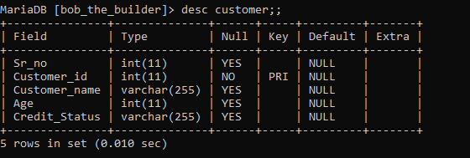
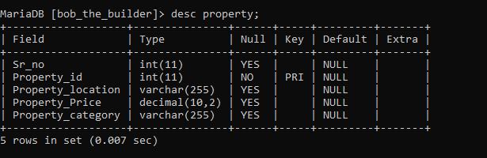
Customer Table
This table contains the details of the Customer table Customer ID, Name, Age, Credit status.
Property Table
This table contains the details of he Property table Property id, Property location, Price, Category.

Slide 4
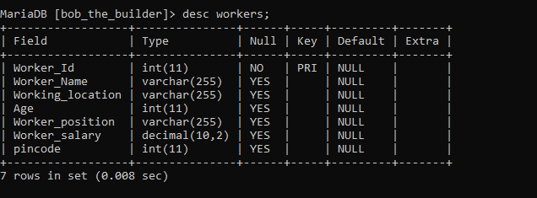
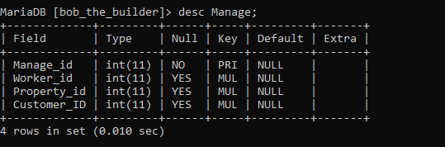
Workers table
This table contains the data of workers like worker id, name, worker Location, Age, Position, worker salary, pincode.
Manage Table
This table contains the data of All foreign keys
All the table customer, Worker, property and linked with manage table.

Slide 5
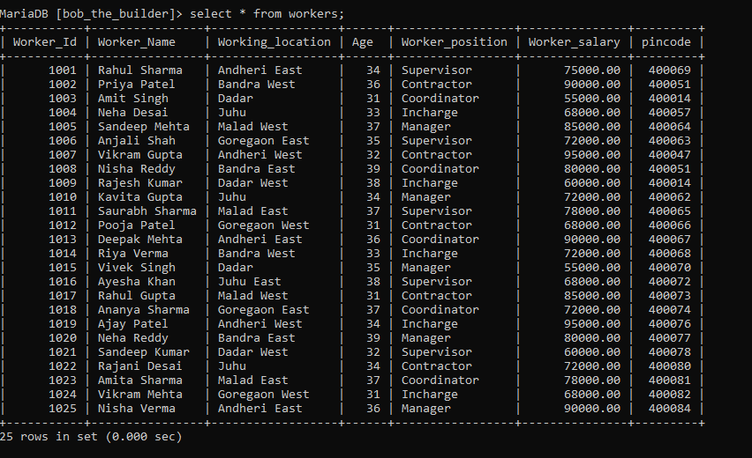
Table of content
WORKER TABLE
It contain 25 Entries of workers with their respected details

Slide 6
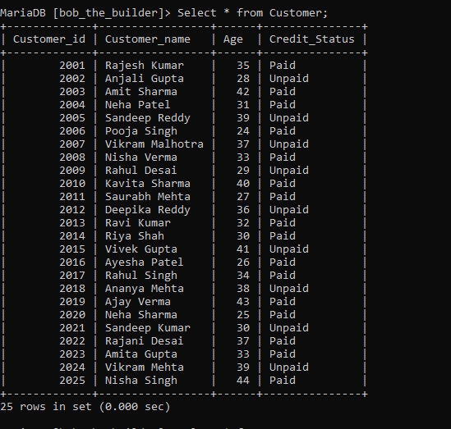
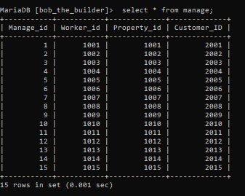
Customer Table
It contains all the entries of the customer respecticely.
Manage Table
It contains all the entries of the ID of the all 3 tables

Slide 7
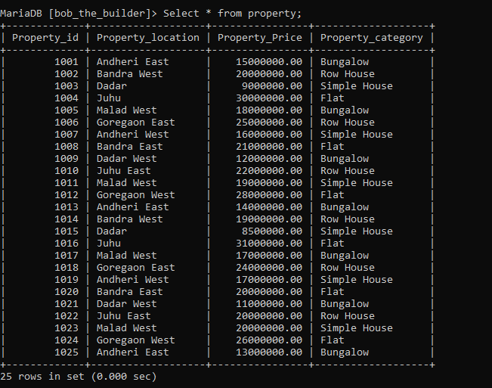
Property Table
Table of property details with its entries respectively.

Slide 8
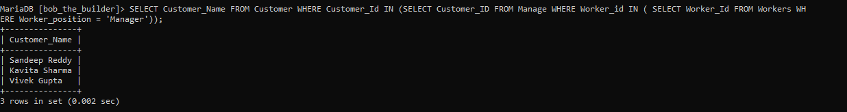
Subquery
1) Find the customers who have properties managed by workers with the position "Manager".
SELECT Customer_Name FROM Customer WHERE Customer_Id IN (SELECT Customer_ID FROM Manage WHERE Worker_id IN ( SELECT Worker_Id FROM Workers WHERE Worker_position = 'Manager'));

Slide 9
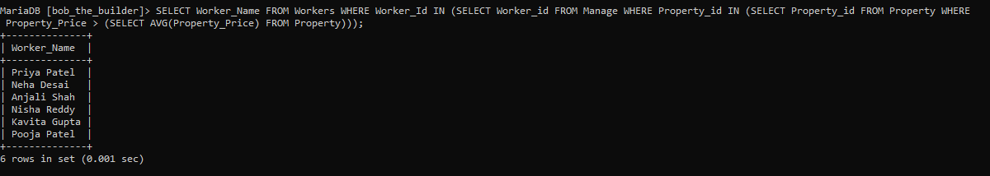
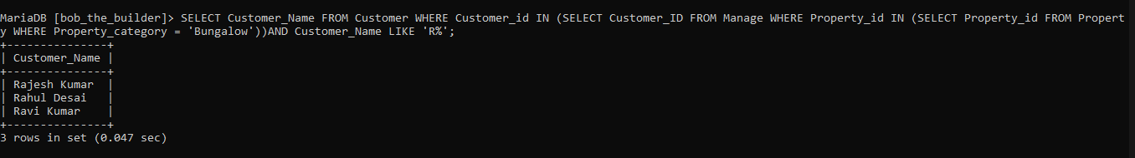
2) Find the workers who have managed properties with a price greater than the average property price.
SELECT Worker_Name FROM Workers WHERE Worker_Id IN (SELECT Worker_id FROM Manage WHERE Property_id IN (SELECT Property_id FROM Property WHERE Property_Price > (SELECT AVG(Property_Price) FROM Property)));
3) Find the workers who have managed properties of category "Bungalow" and have customers with the name starting with"R".
SELECT Customer_Name FROM Customer WHERE Customer_id IN (SELECT Customer_ID FROM Manage WHERE Property_id IN (SELECT Property_id FROM Property WHERE Property_category = 'Bungalow'))AND Customer_Name LIKE 'R%';

Slide 10
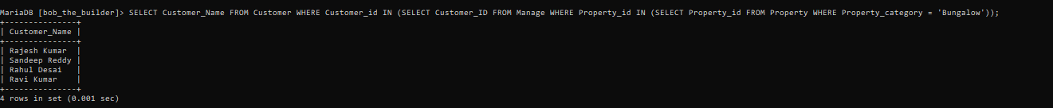
4) Find Customers Who buy Bunglow
SELECT Customer_Name FROM Customer WHERE Customer_id IN (SELECT Customer_ID FROM Manage WHERE Property_id IN (SELECT Property_id FROM Property WHERE Property_category = 'Bungalow'));

Slide 11
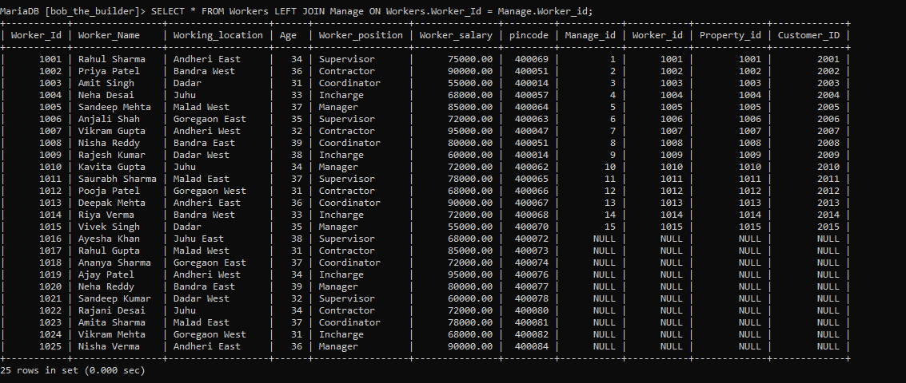
JOINS
Left join
Retrieve all workers along with their corresponding management details , including workers who have no management records.
SELECT * FROM Workers LEFT JOIN Manage ON Workers.Worker_Id = Manage.Worker_id;

Slide 12
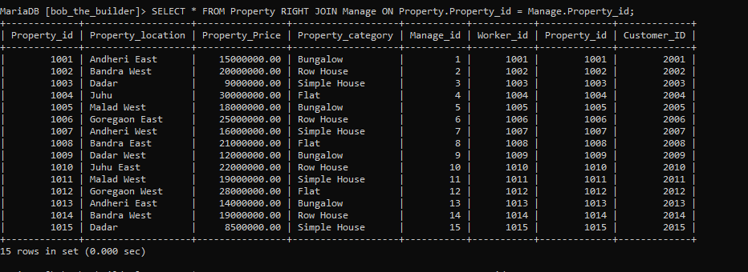
2) Retrieve all properties, including those without any management records, along with their corresponding management details
SELECT * FROM Property RIGHT JOIN Manage ON Property.Property_id = Manage.Property_id;

Slide 13
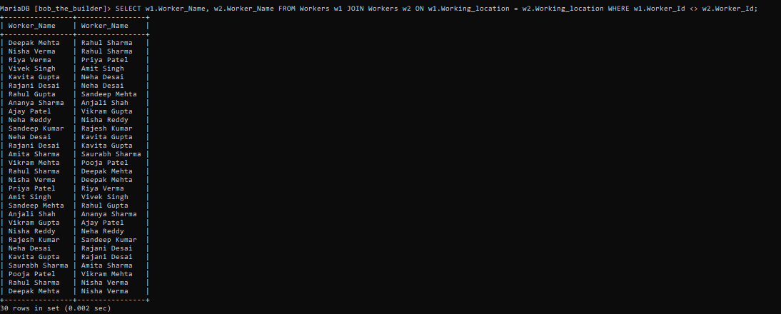
Self join
3) To retrieve the workers who have the same working location as another worker:
SELECT w1.Worker_Name, w2.Worker_Name FROM Workers w1 JOIN Workers w2 ON w1.Working_location = w2.Working_location WHERE w1.Worker_Id <> w2.Worker_Id;

